Slide 1







Gaming Recommendations on Steam
A dataset of games, users and reviews for building recommendation systems.
START

Slide 2


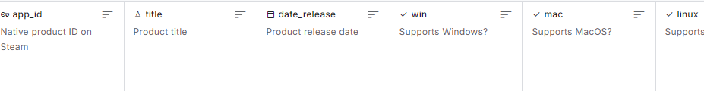
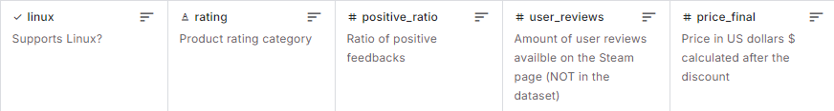
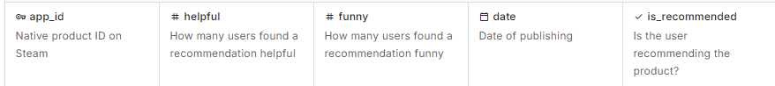
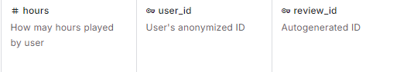

Games Table Content
.
Recommendations Table Content

Slide 3
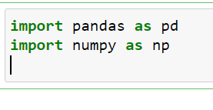
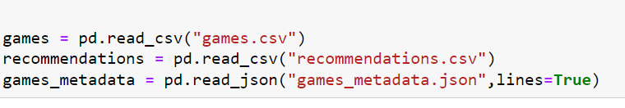
Importing Libraries
.
Reading Tables

Slide 4

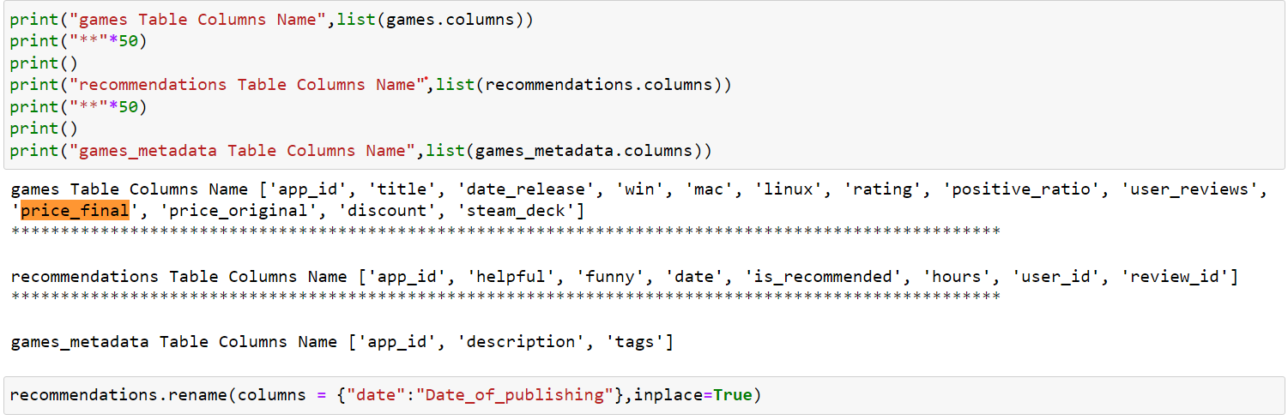


Understanding Data
Checking Columns Names
Introduction
Our Proess
AbtUs
Elaborate on what you want to discuss.
Elaborate n what you want to discuss.

Slide 5
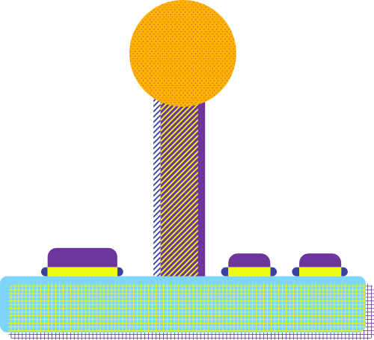

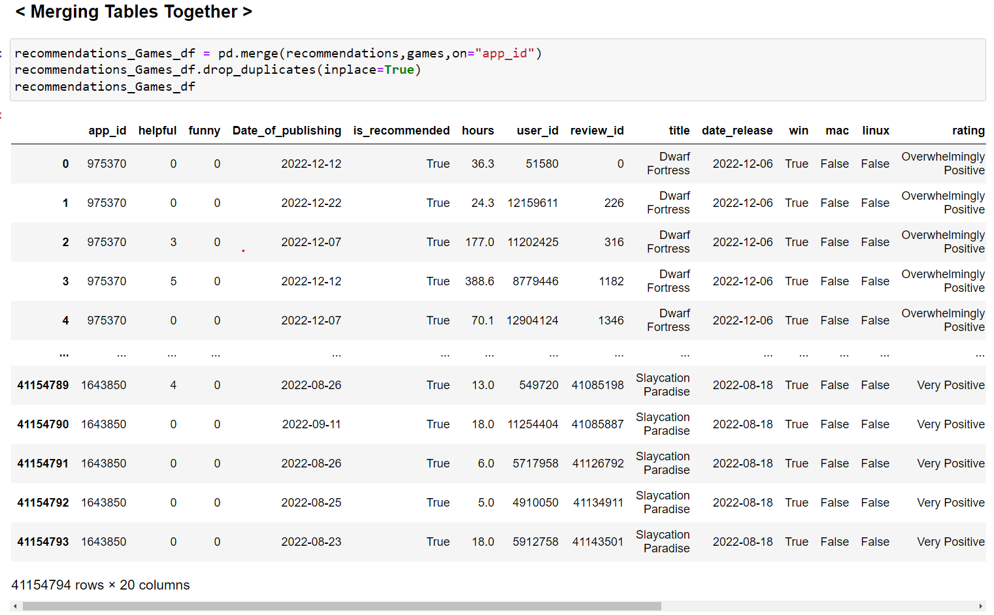

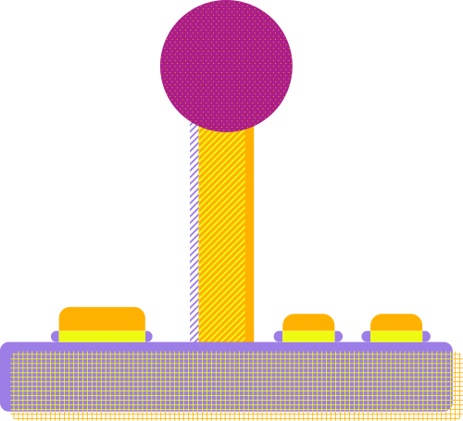
Merging Tables

Slide 6

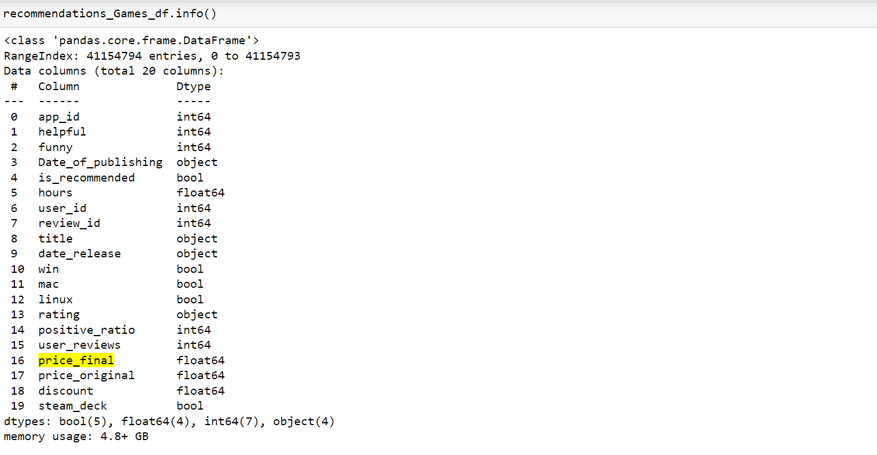
Checking Columns Data Types

Slide 7
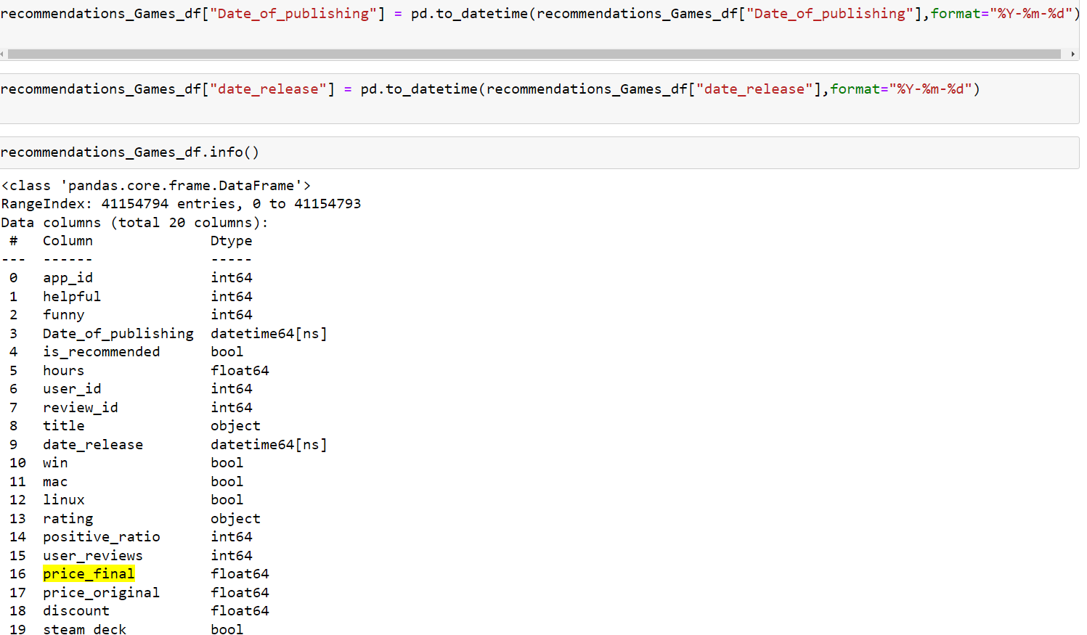


Changing Date Type from object to datetime

Slide 8

Dropping unnecessary columns

Slide 9

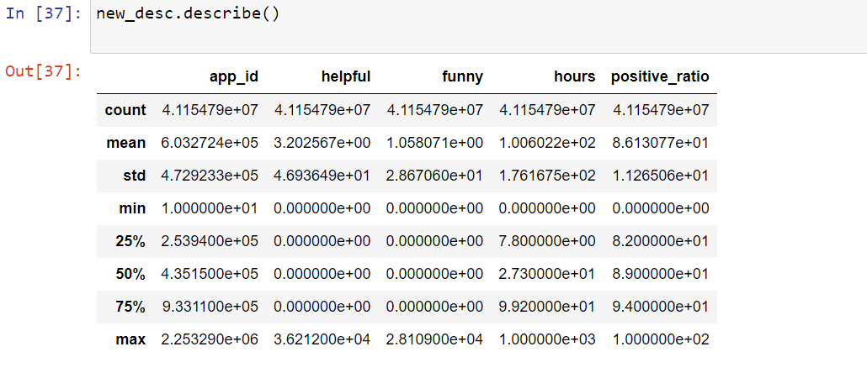
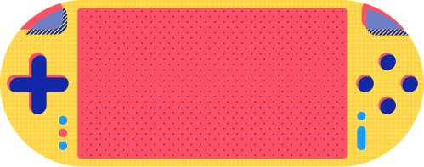
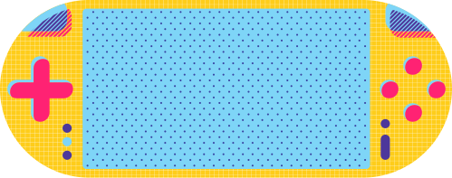
Describe Numerical Columns
Recommendation Table

Slide 10

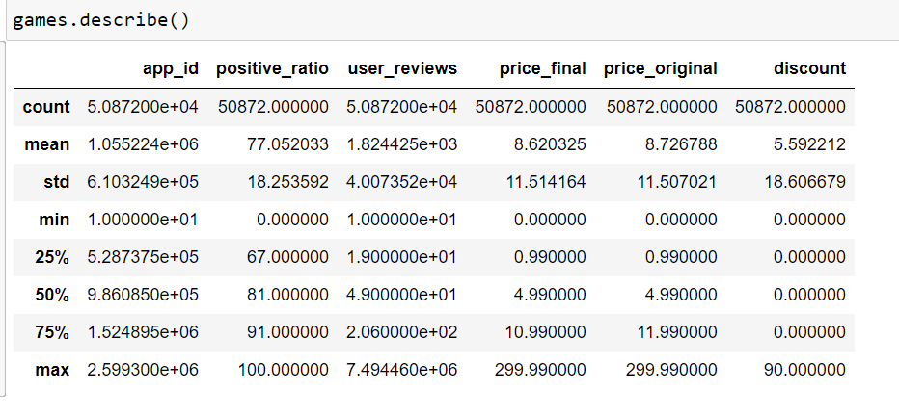

Describe Numerical Columns
Games Table

Slide 11
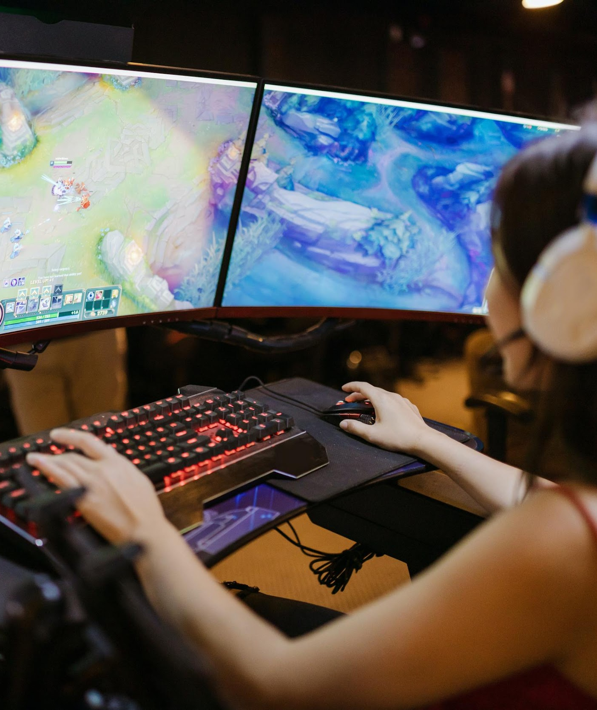
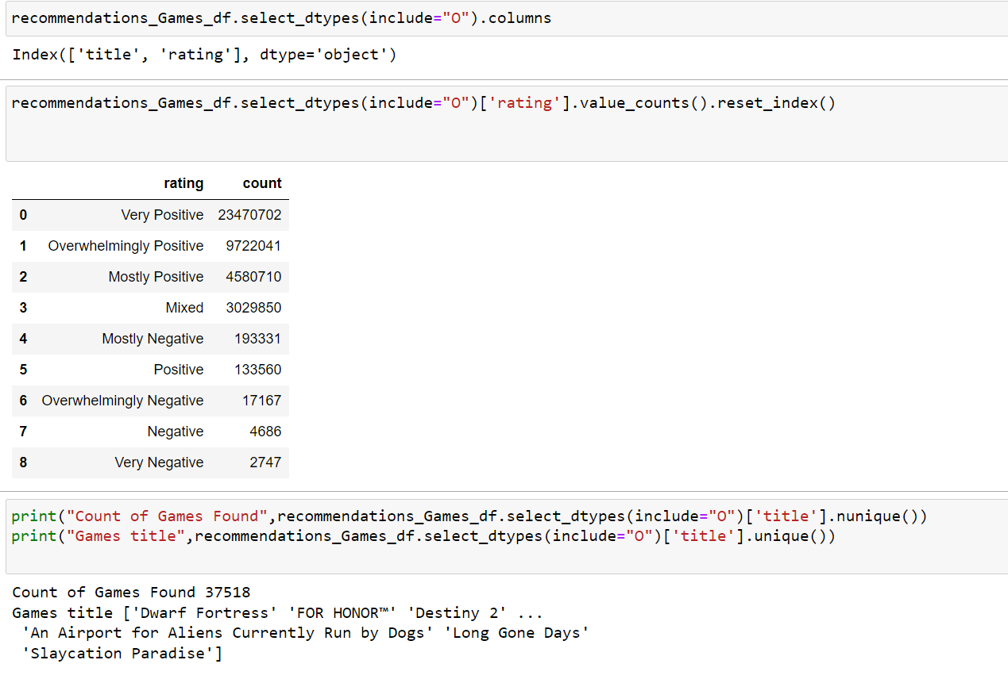
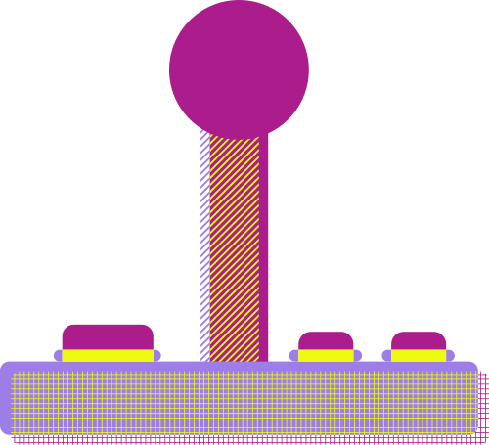
Describe Categorical Columns

Slide 12

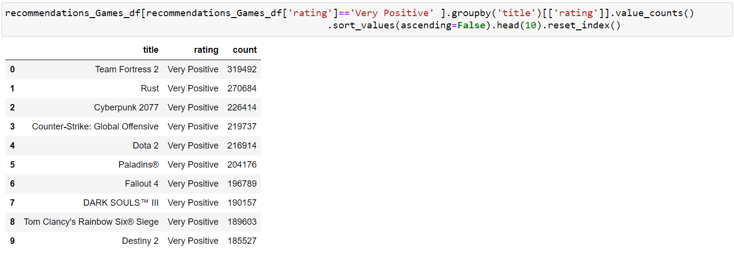


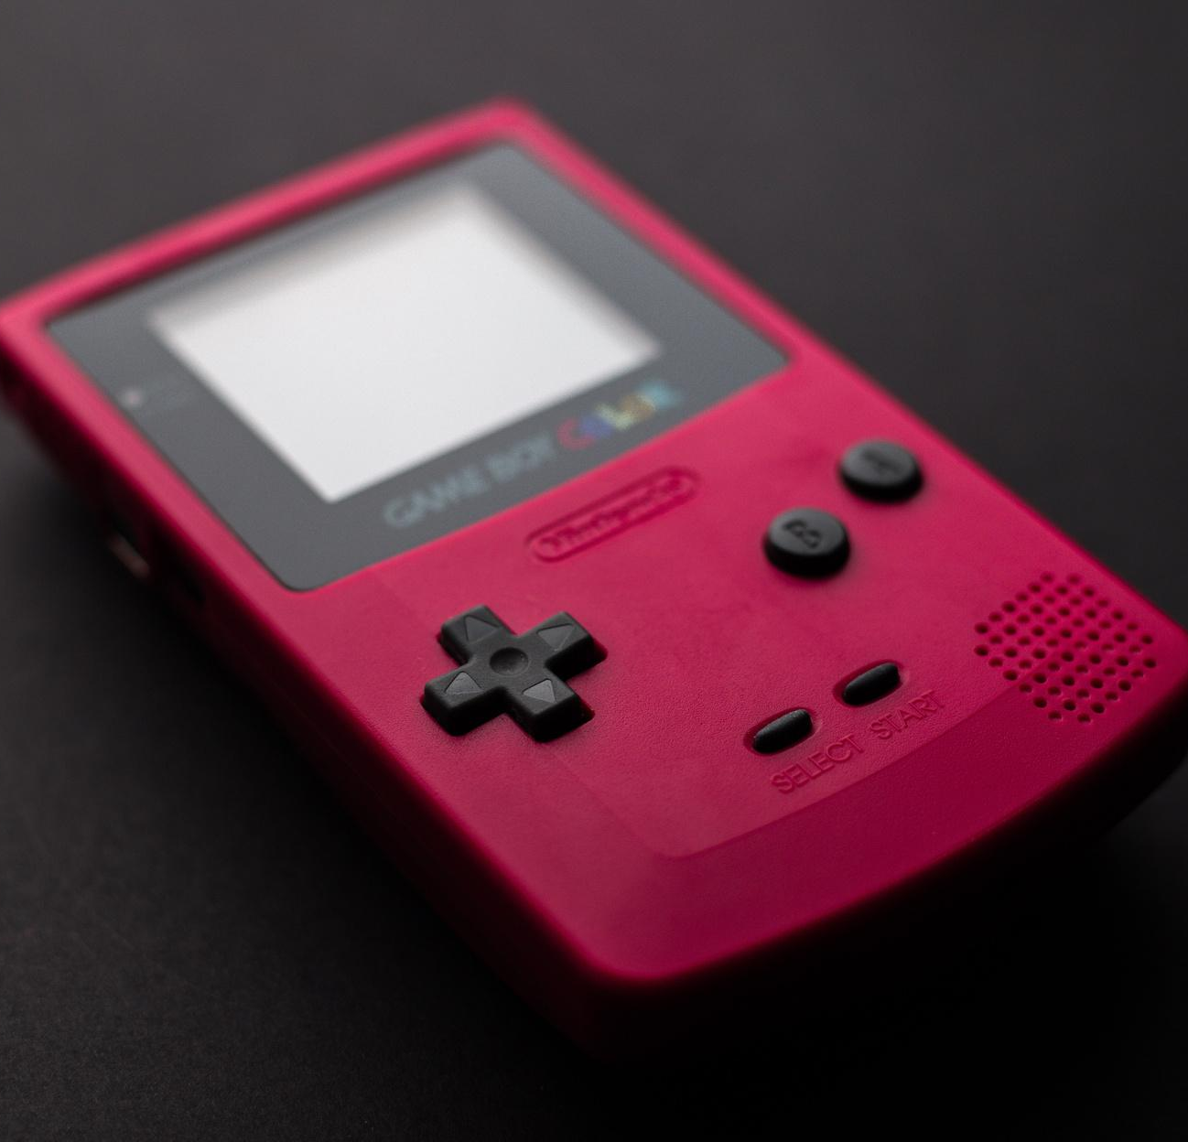
EDA Questions
Top 10 Games With Rating 'Very Positive'

Slide 13
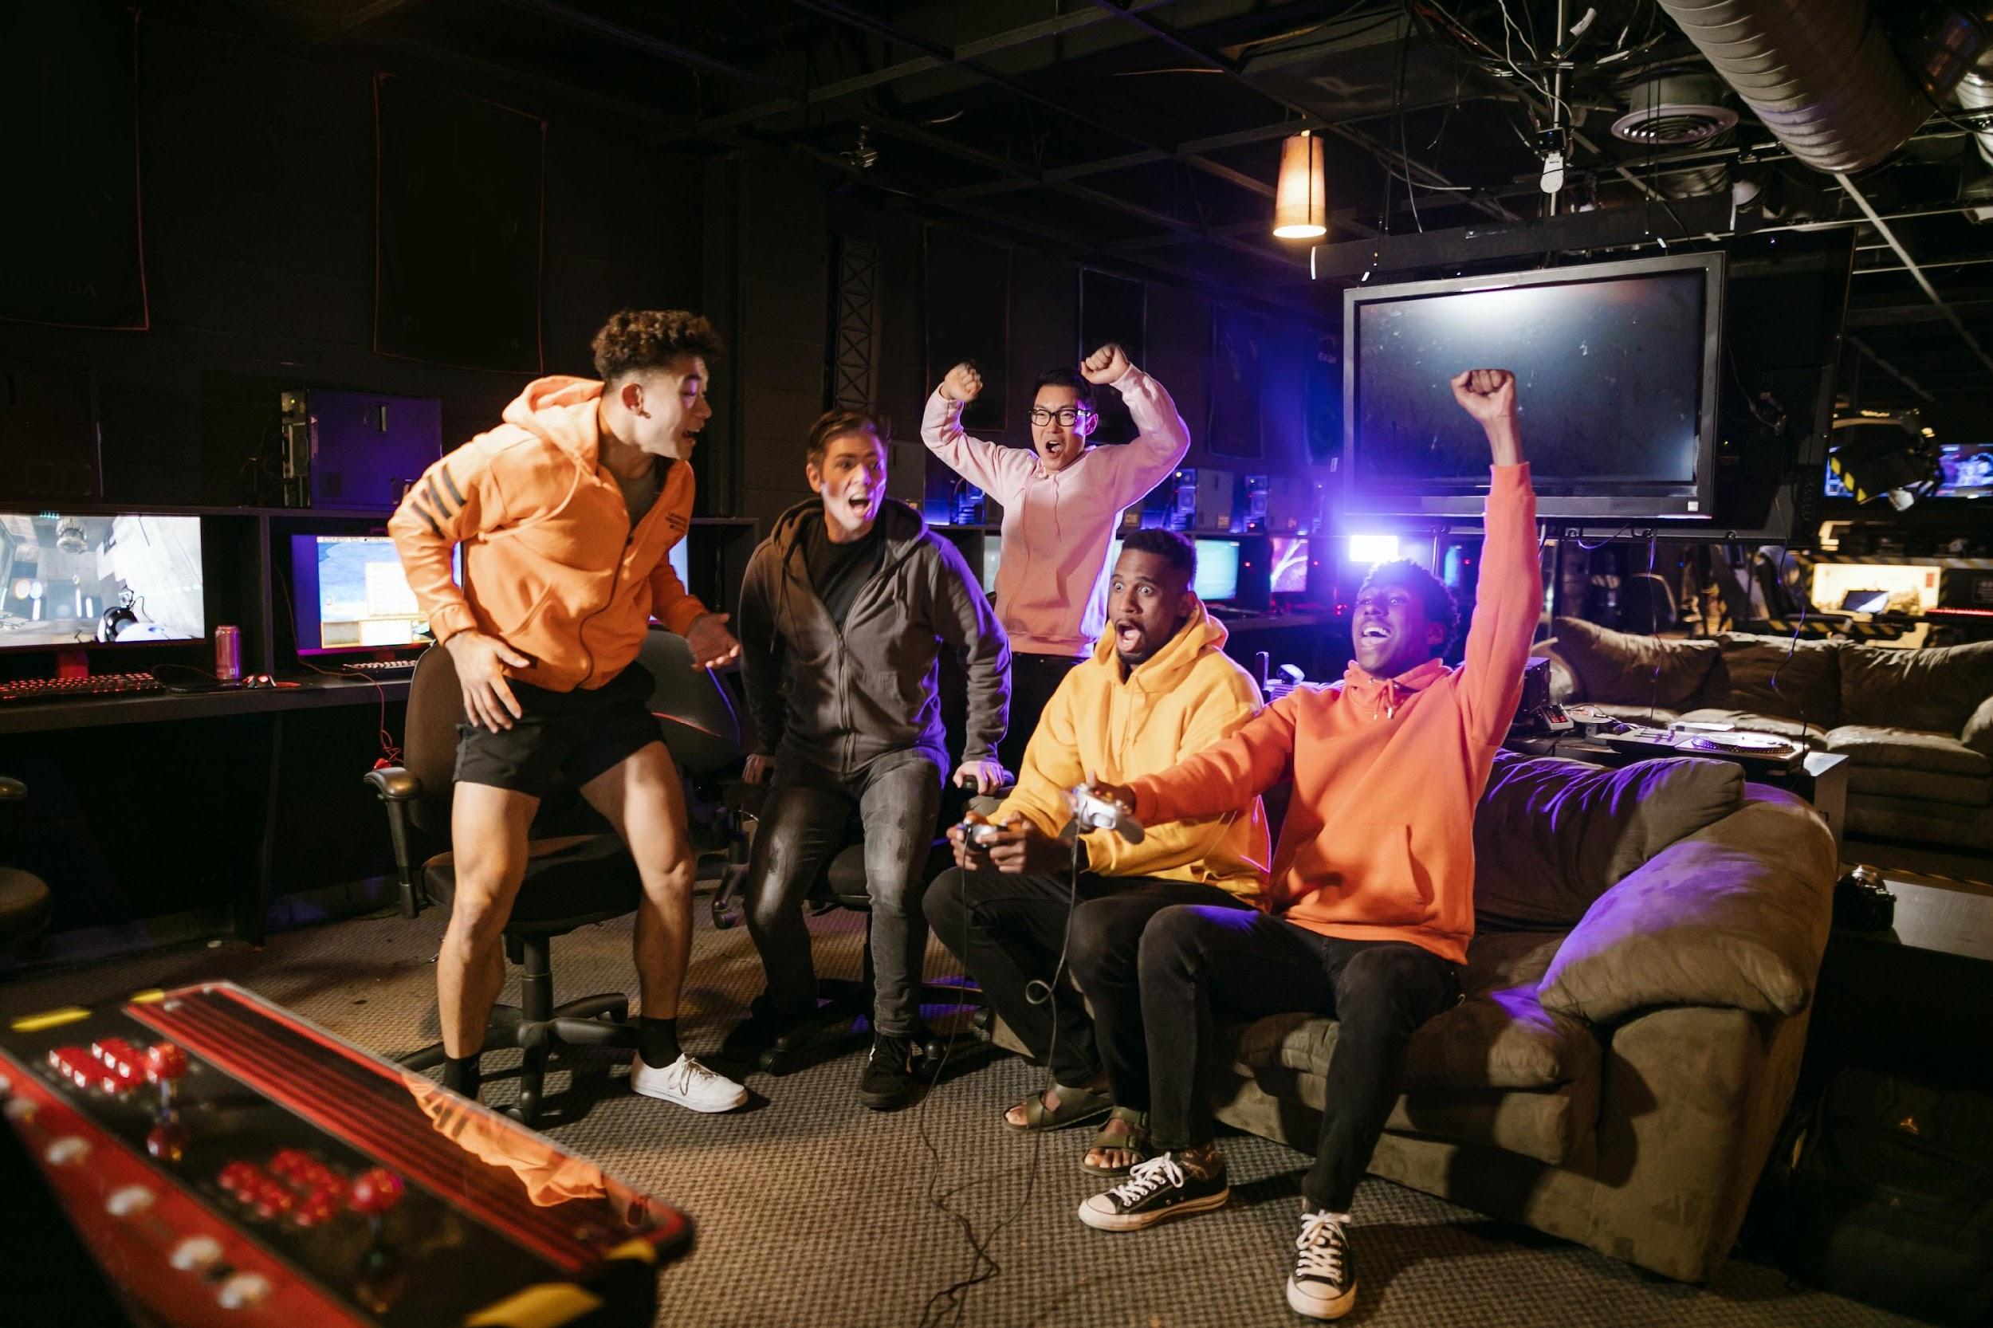

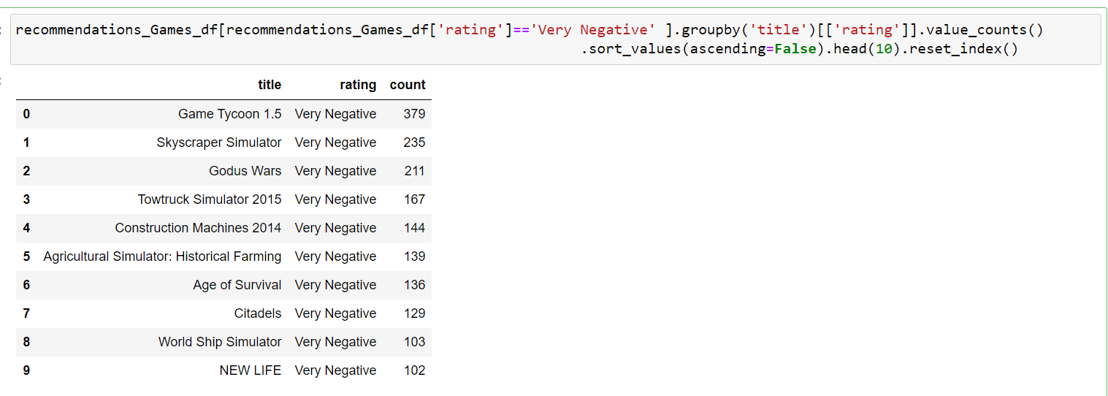
EDA Questions
Top 10 Games With Rating 'Very Negative'

Slide 14

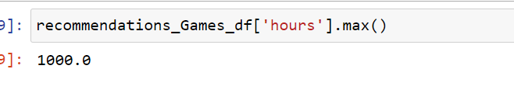

EDA Questions
Max Time Spent playing by user

Slide 15
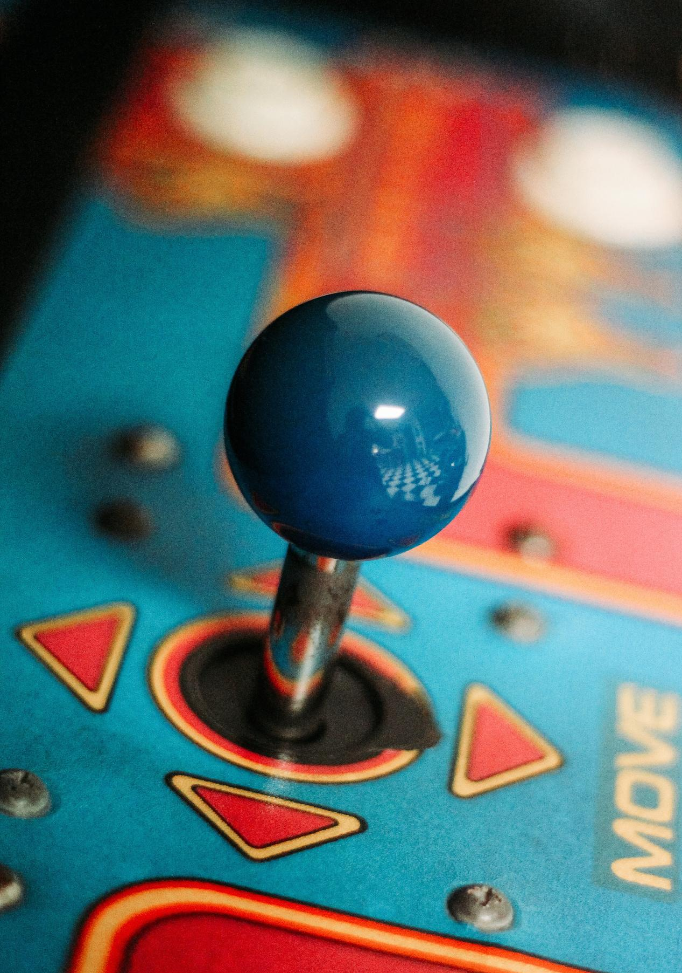

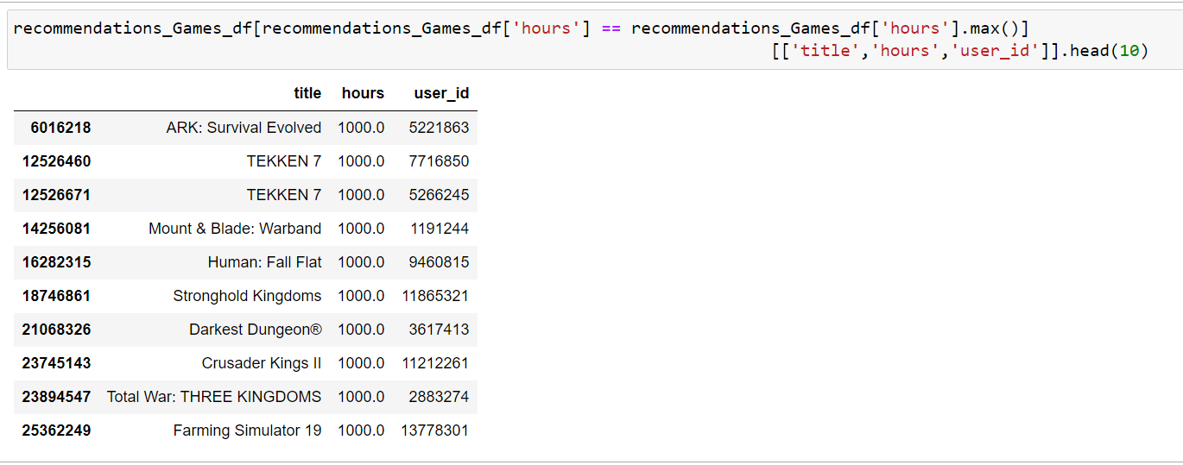
EDA Questions
Top 10 games with much time Spent by users

Slide 16
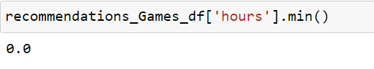
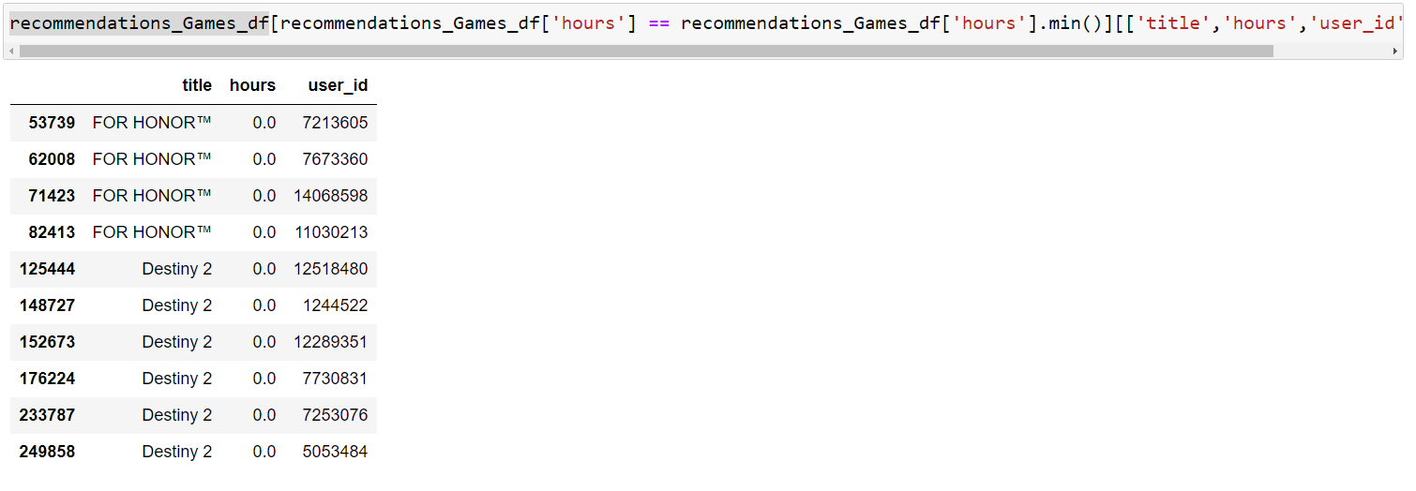

EDA Questions
Min Time Spent Playing by user
10 games with least Hours played by users

Slide 17
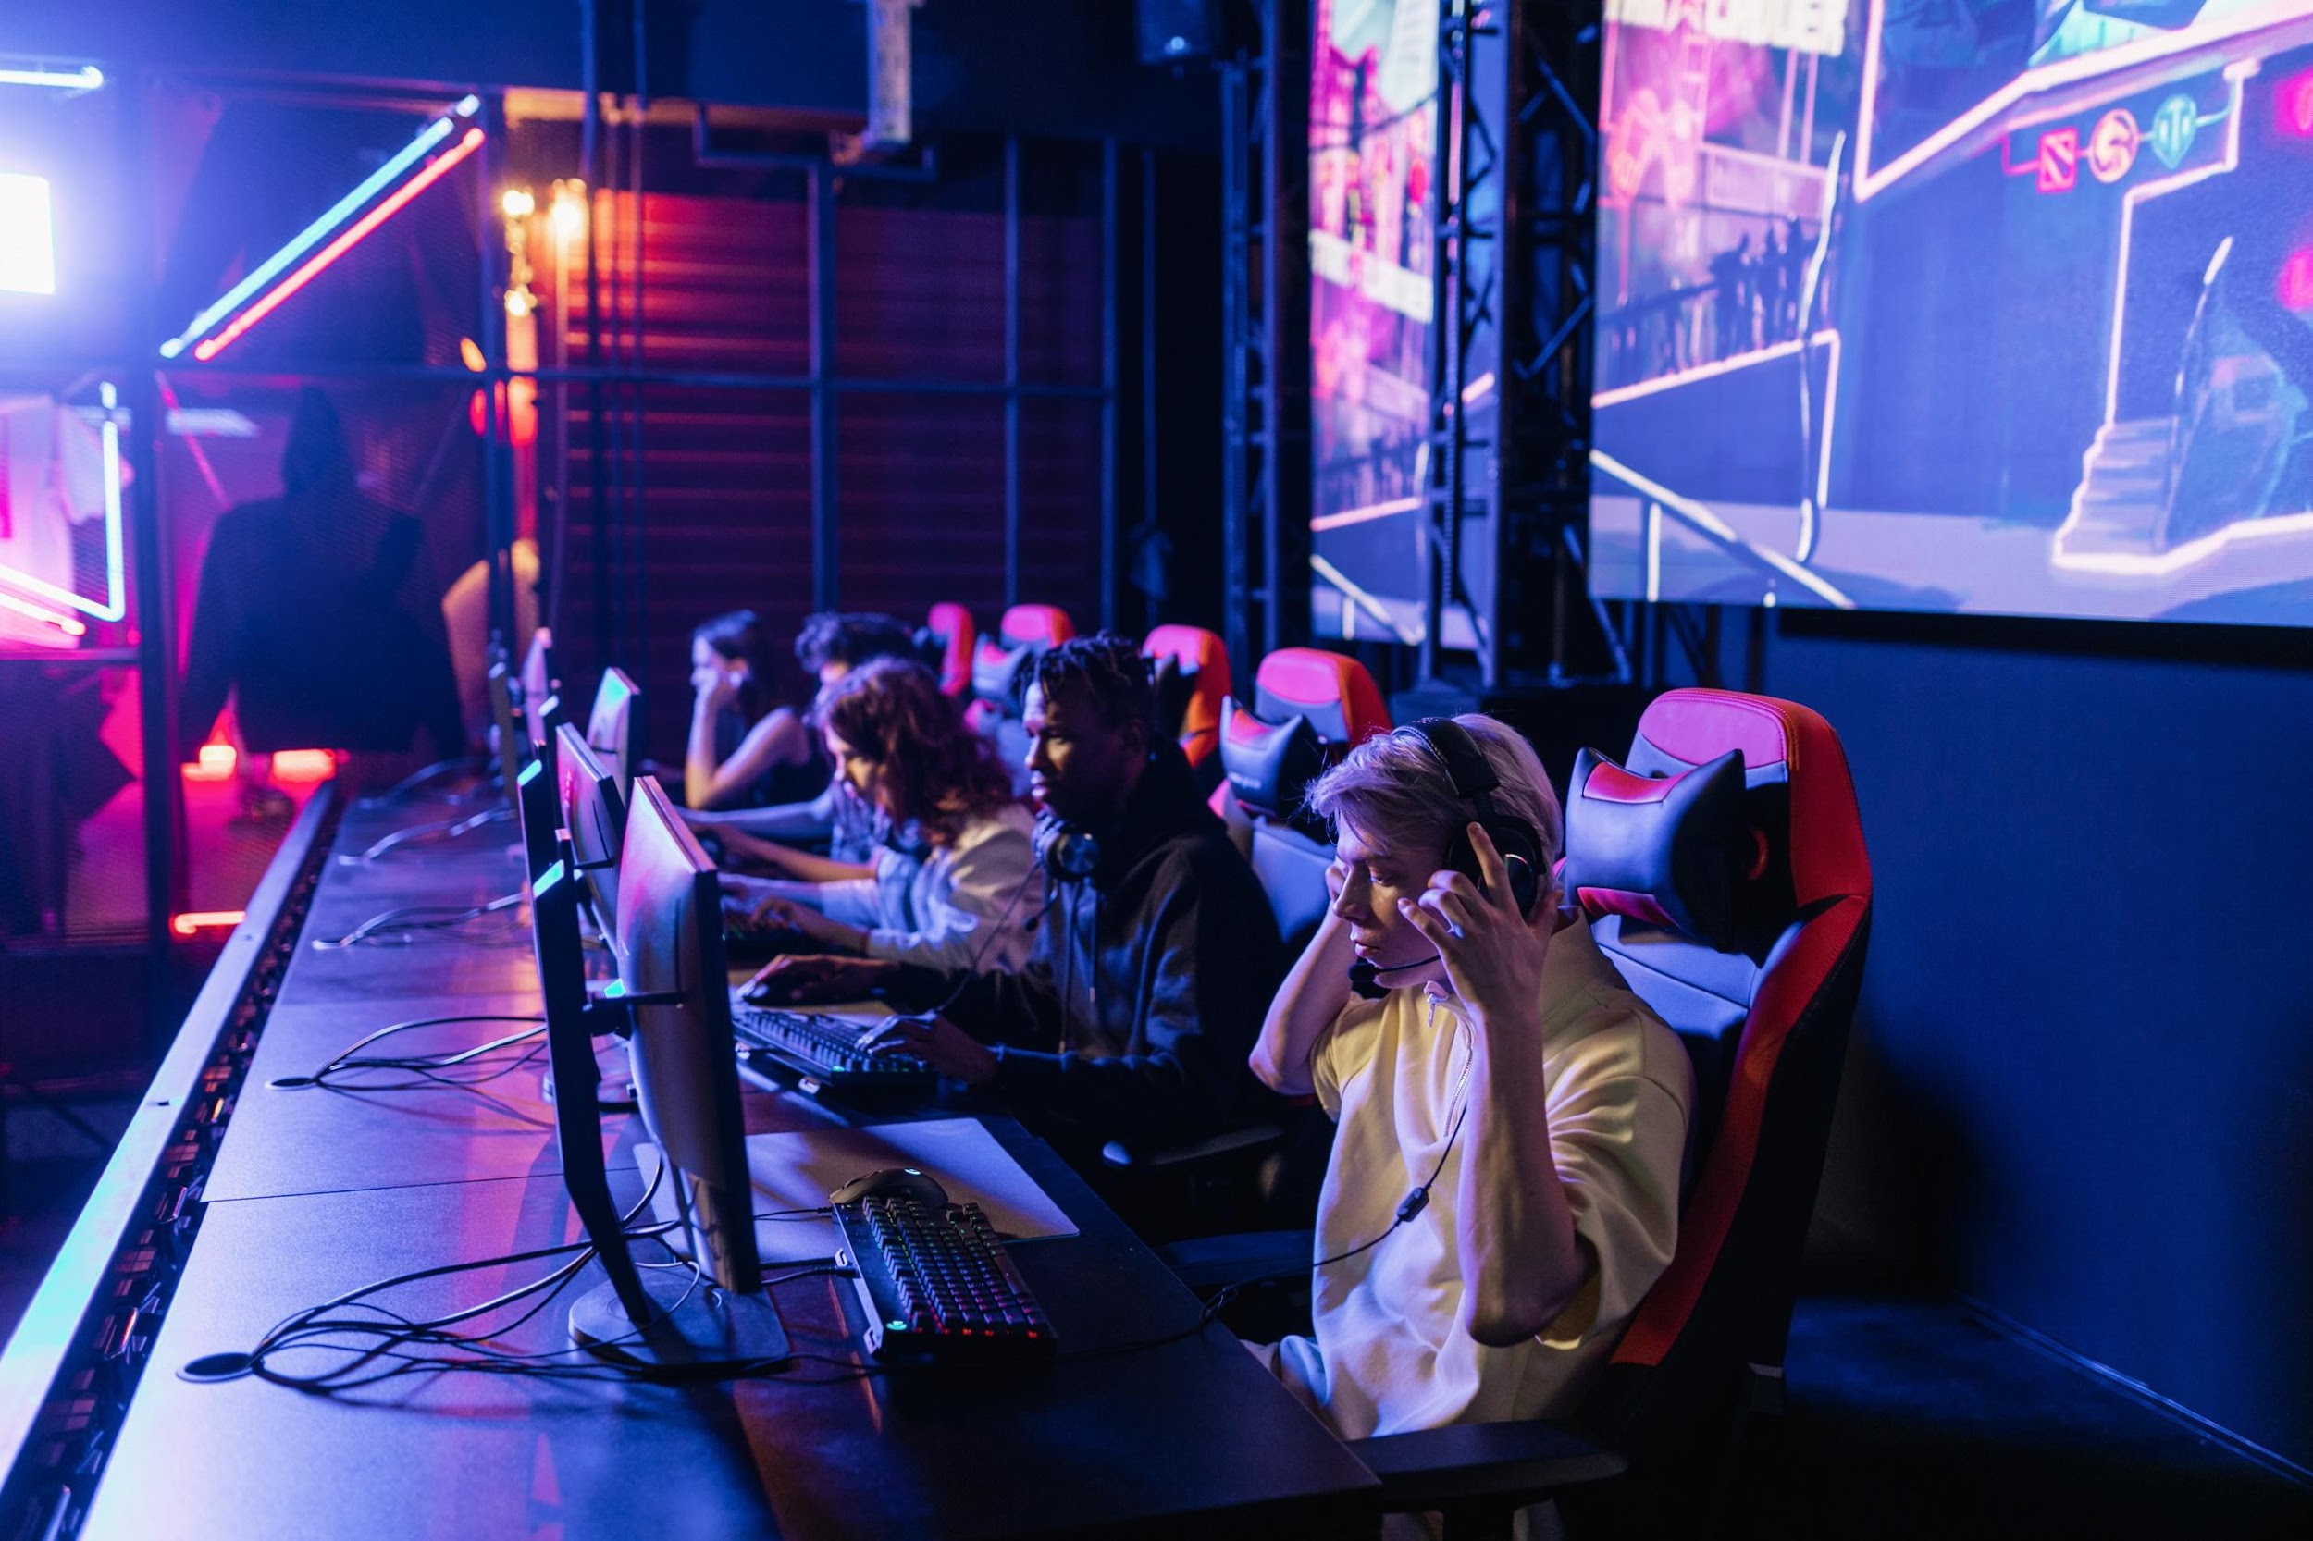

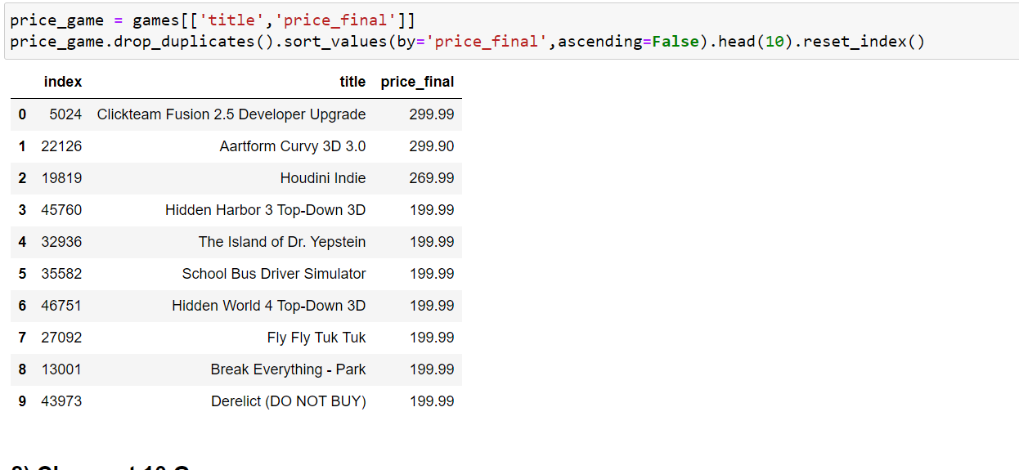
EDA Questions
Most Expansive 10 Games

Slide 18

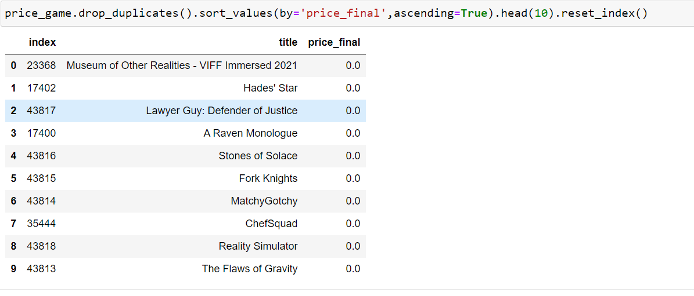
EDA Questions
Cheapest 10 Games

Slide 19
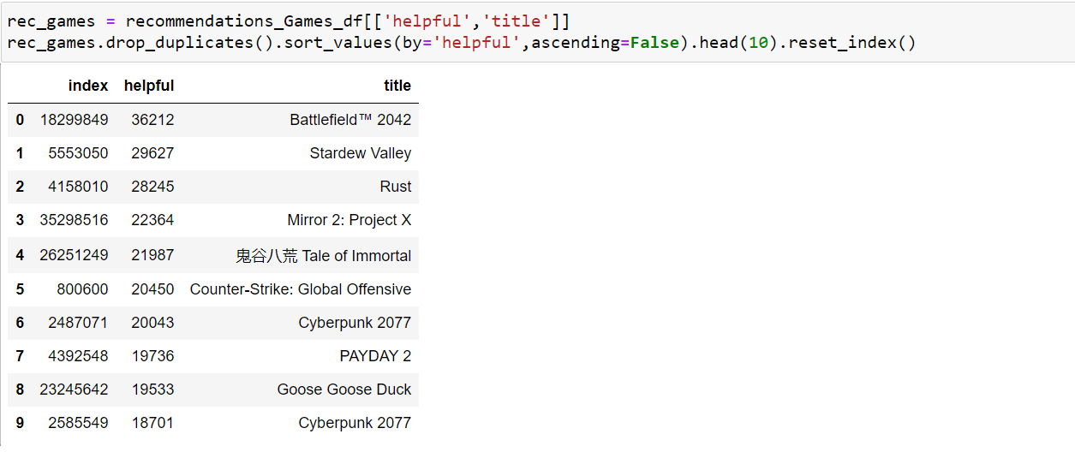
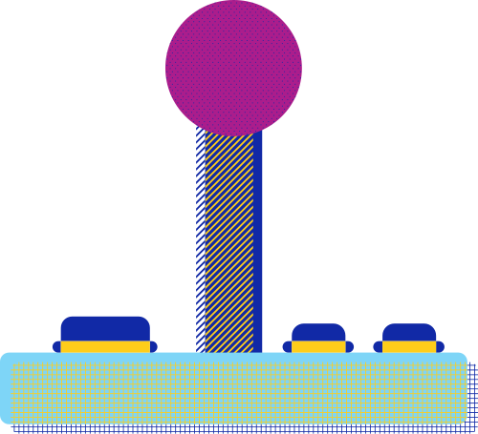
EDA Questions
top ten most Recommended games by users

Slide 20

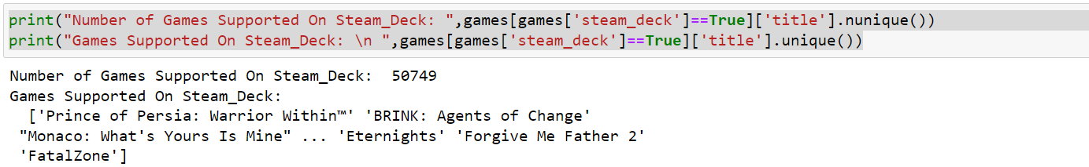
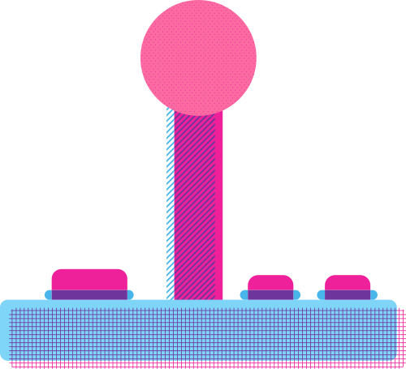
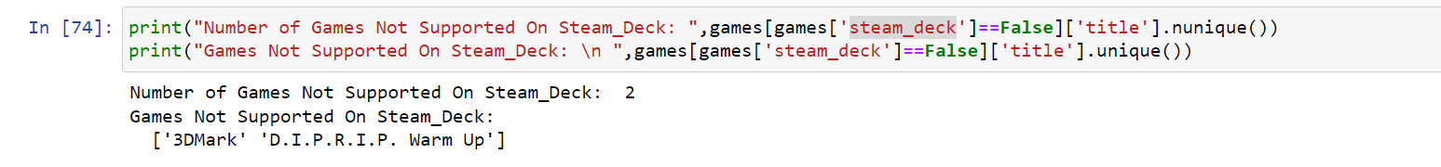
EDA Questions
Games Supported on Steam_Deck
Games Not Supported on Steam_Deck

Slide 21


Thank you!
Eslam Mohamed
https://github.com/Eslam-Abd-El-Salam/Steam-Recomendation-Games-EDA

